Slide 1
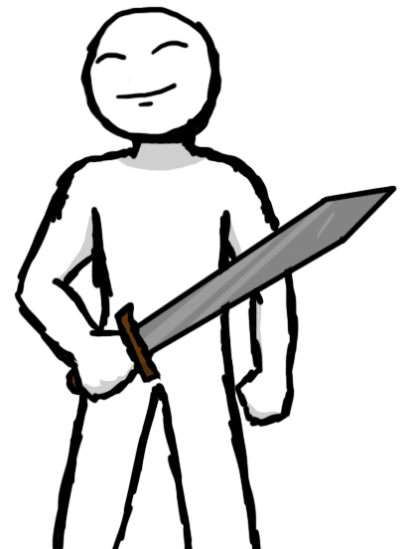
A Touch of Fun – The Creation of Dr. Meme
Kenneth Diedrich
Paul Doody
Alexander Rogic
Notes:
Alex – 8 sec

Slide 2
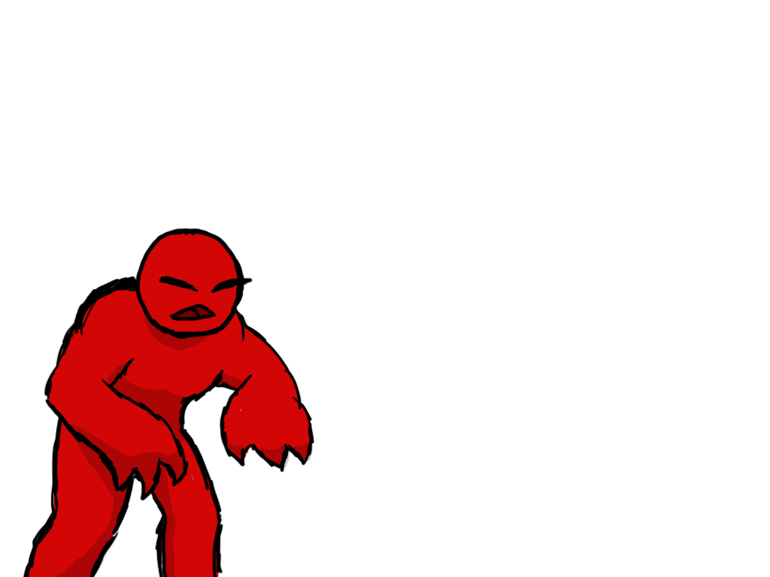
Overview
4
Unique genre to touch screens
To win? Survive the onslaught
Avoid death and prevent the castle from being overrun
Command troops and collect gear to aid your mission
Notes:
Paul – 22 sec

Slide 3

Idea Conception
1
Wanted to do something unique; bring a new type of game to touch screen devices
Notes:
Alex – 19 sec

Slide 4
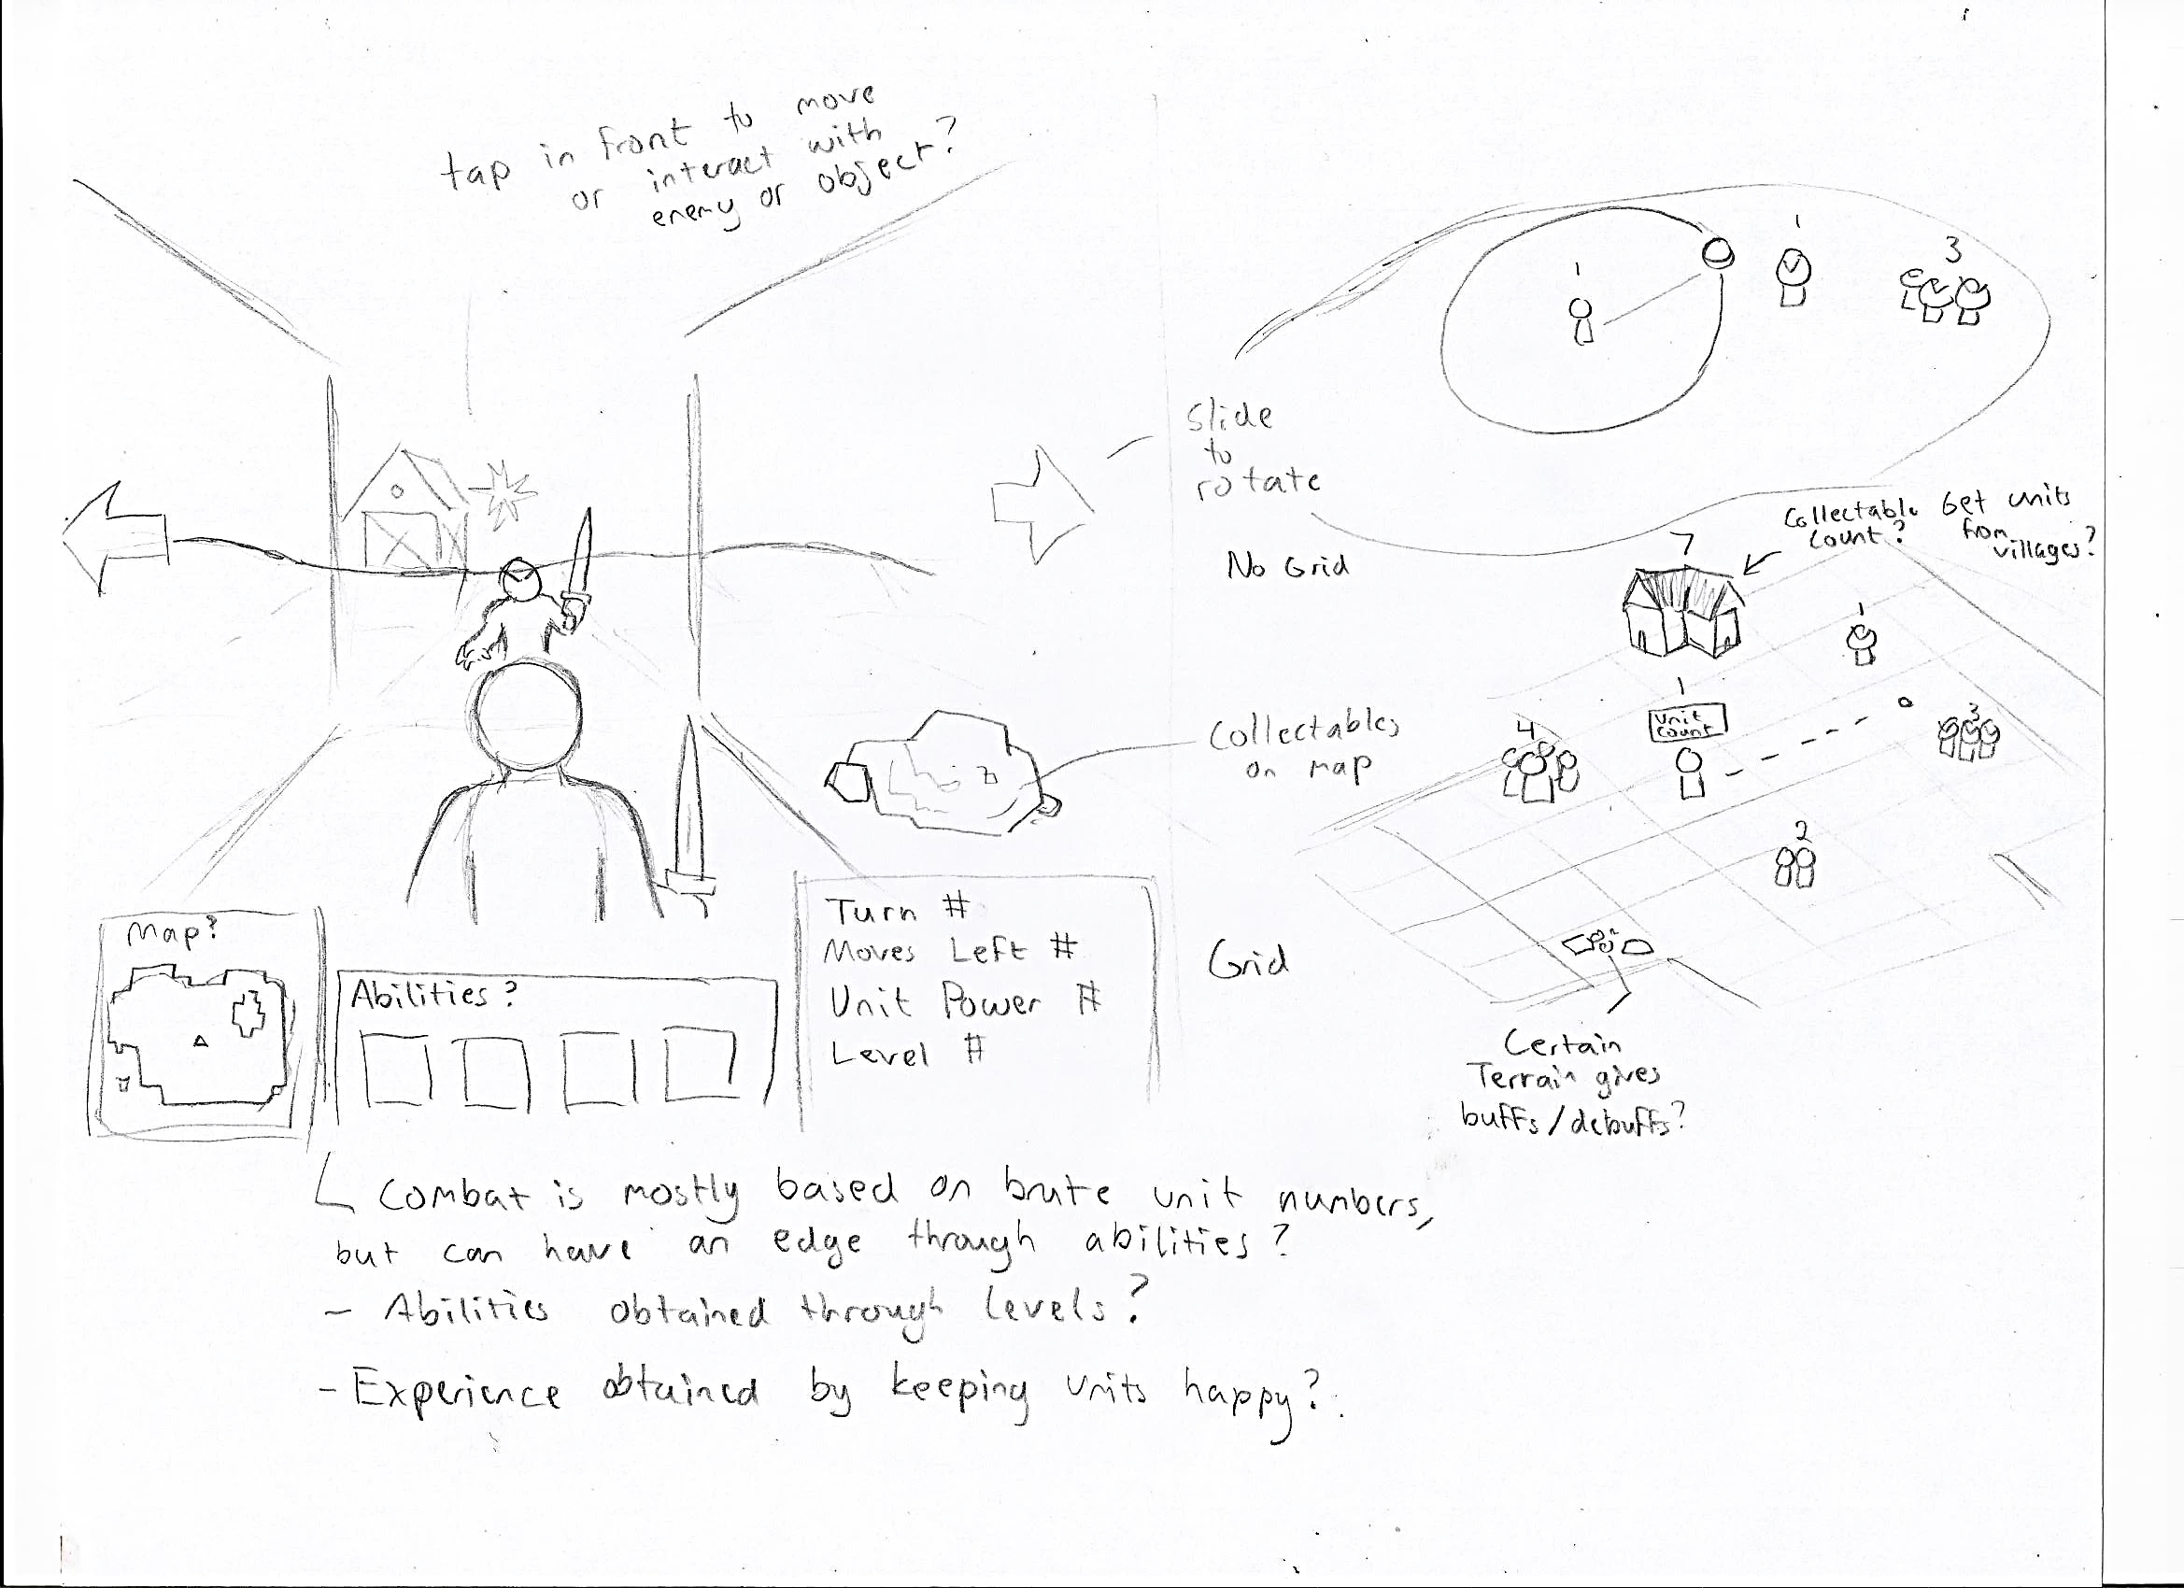

Slide 5
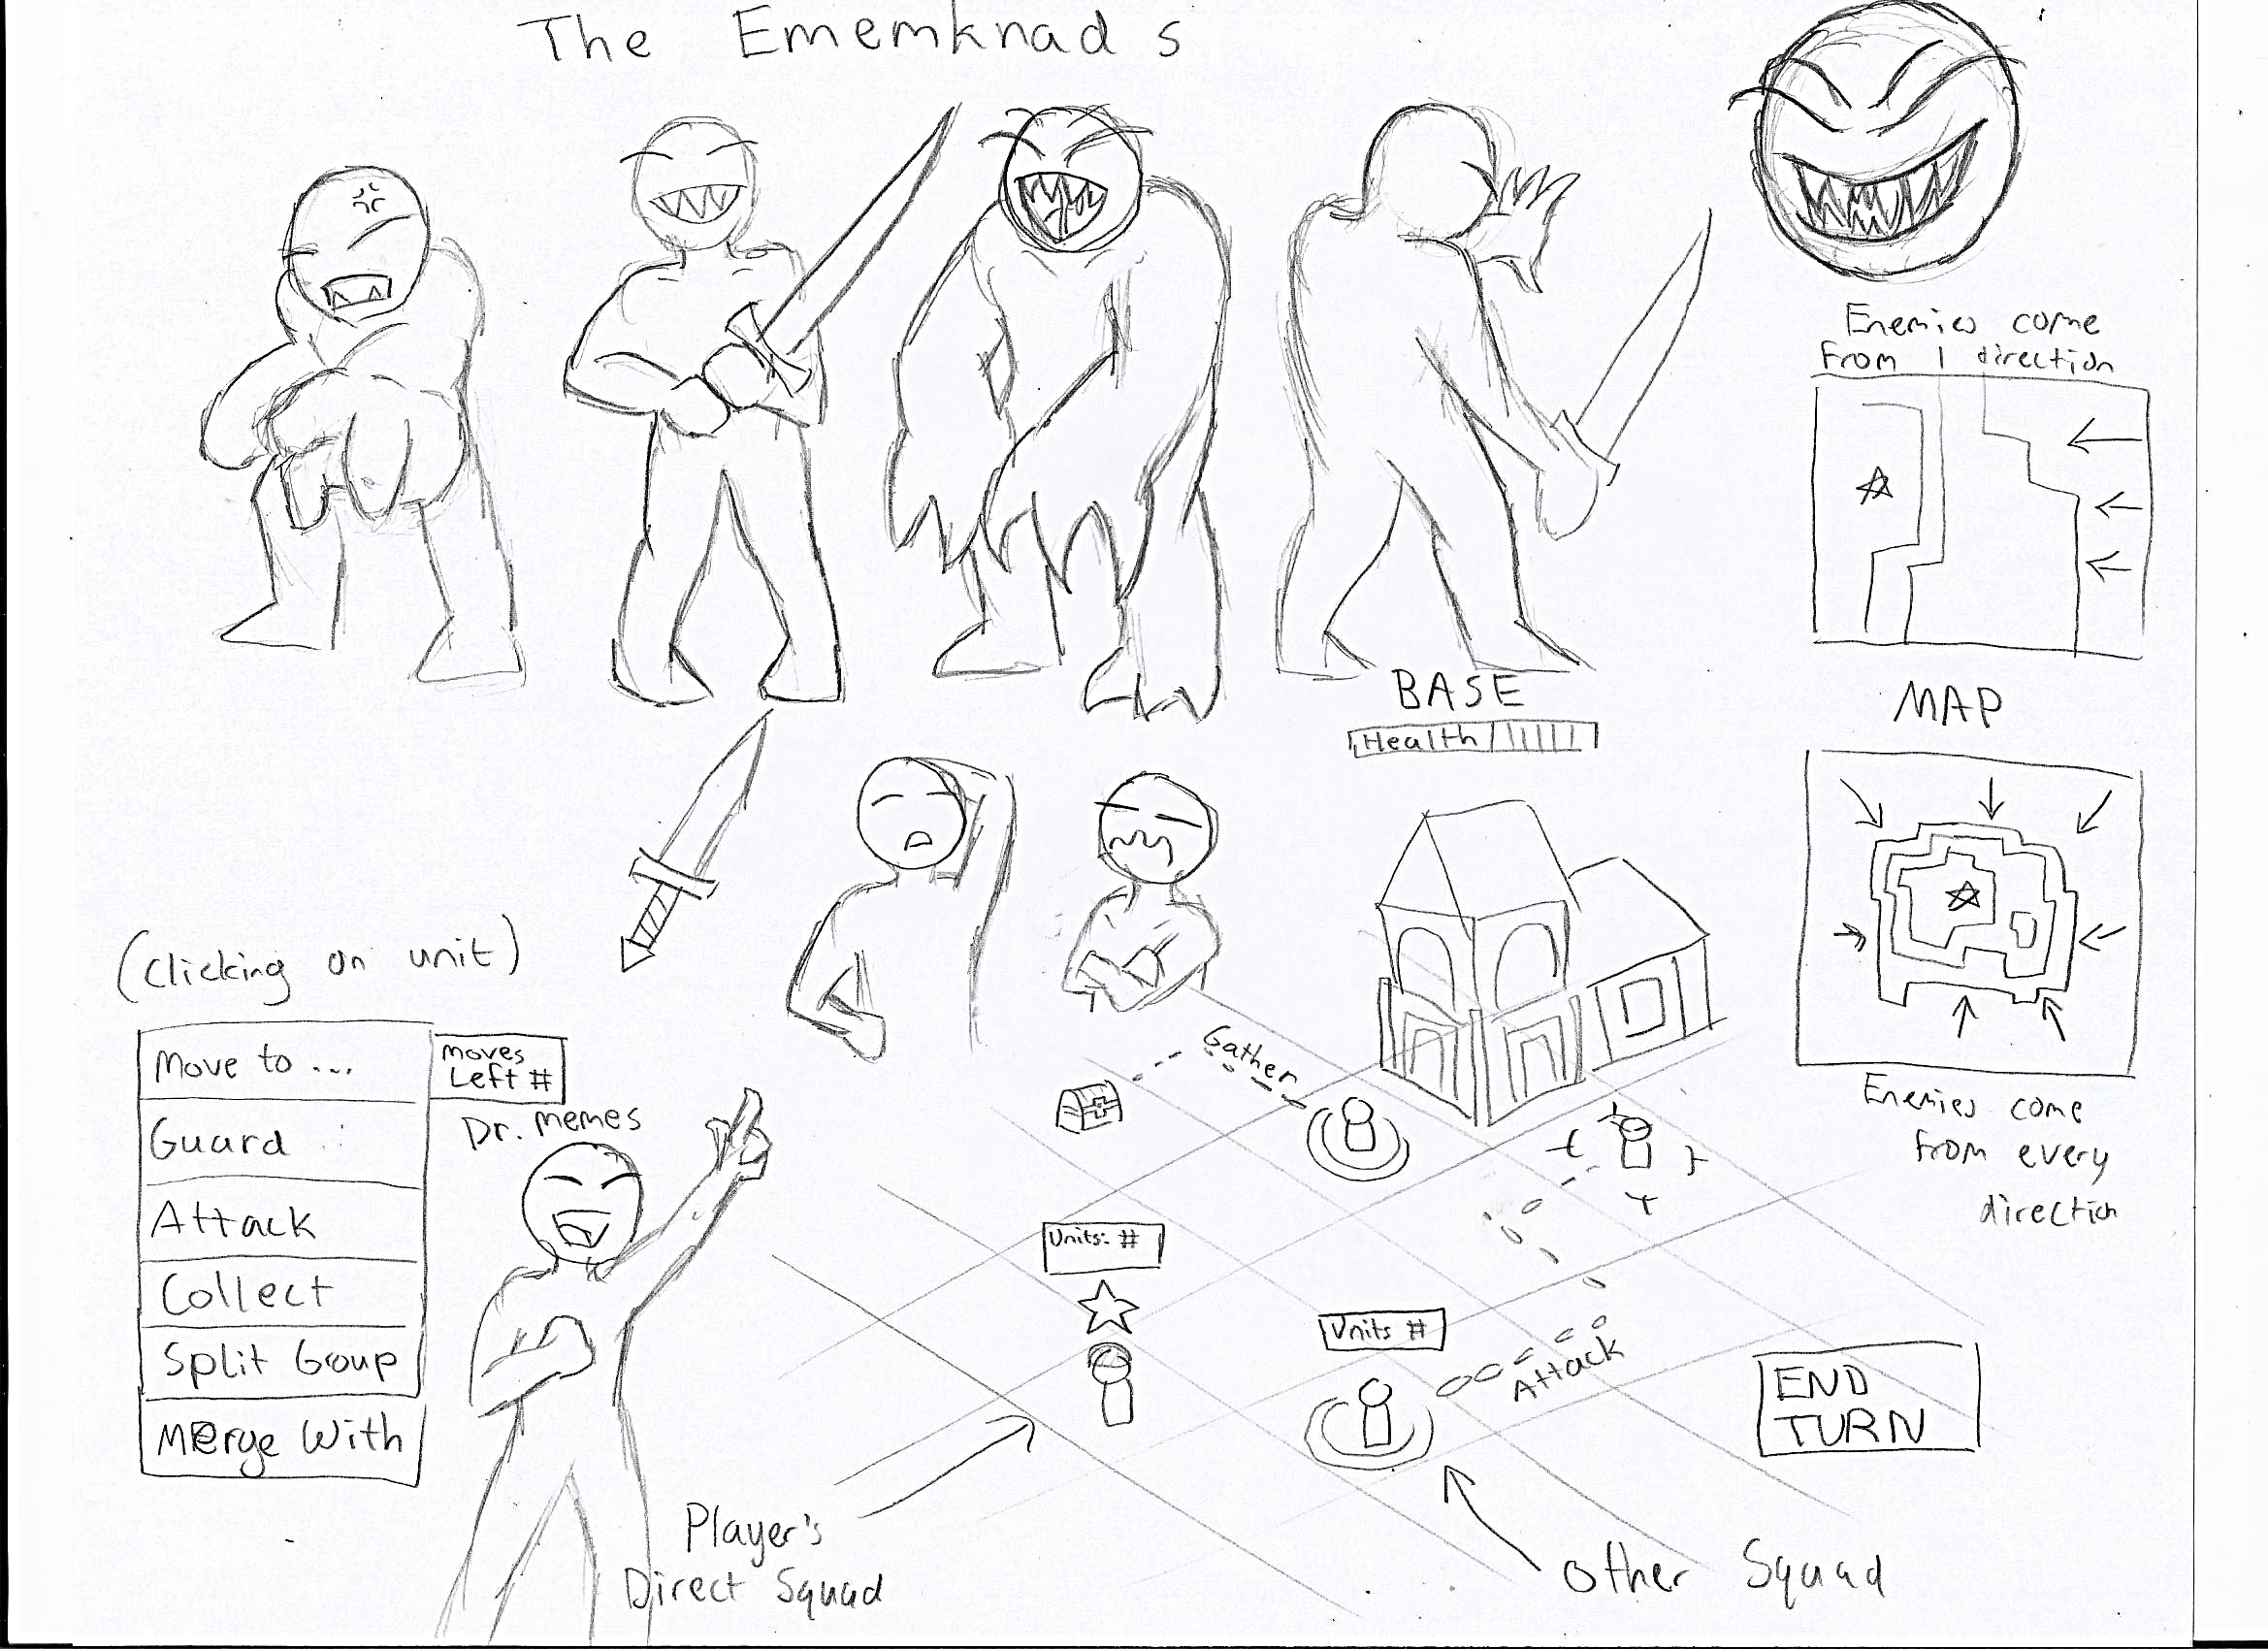

Slide 6
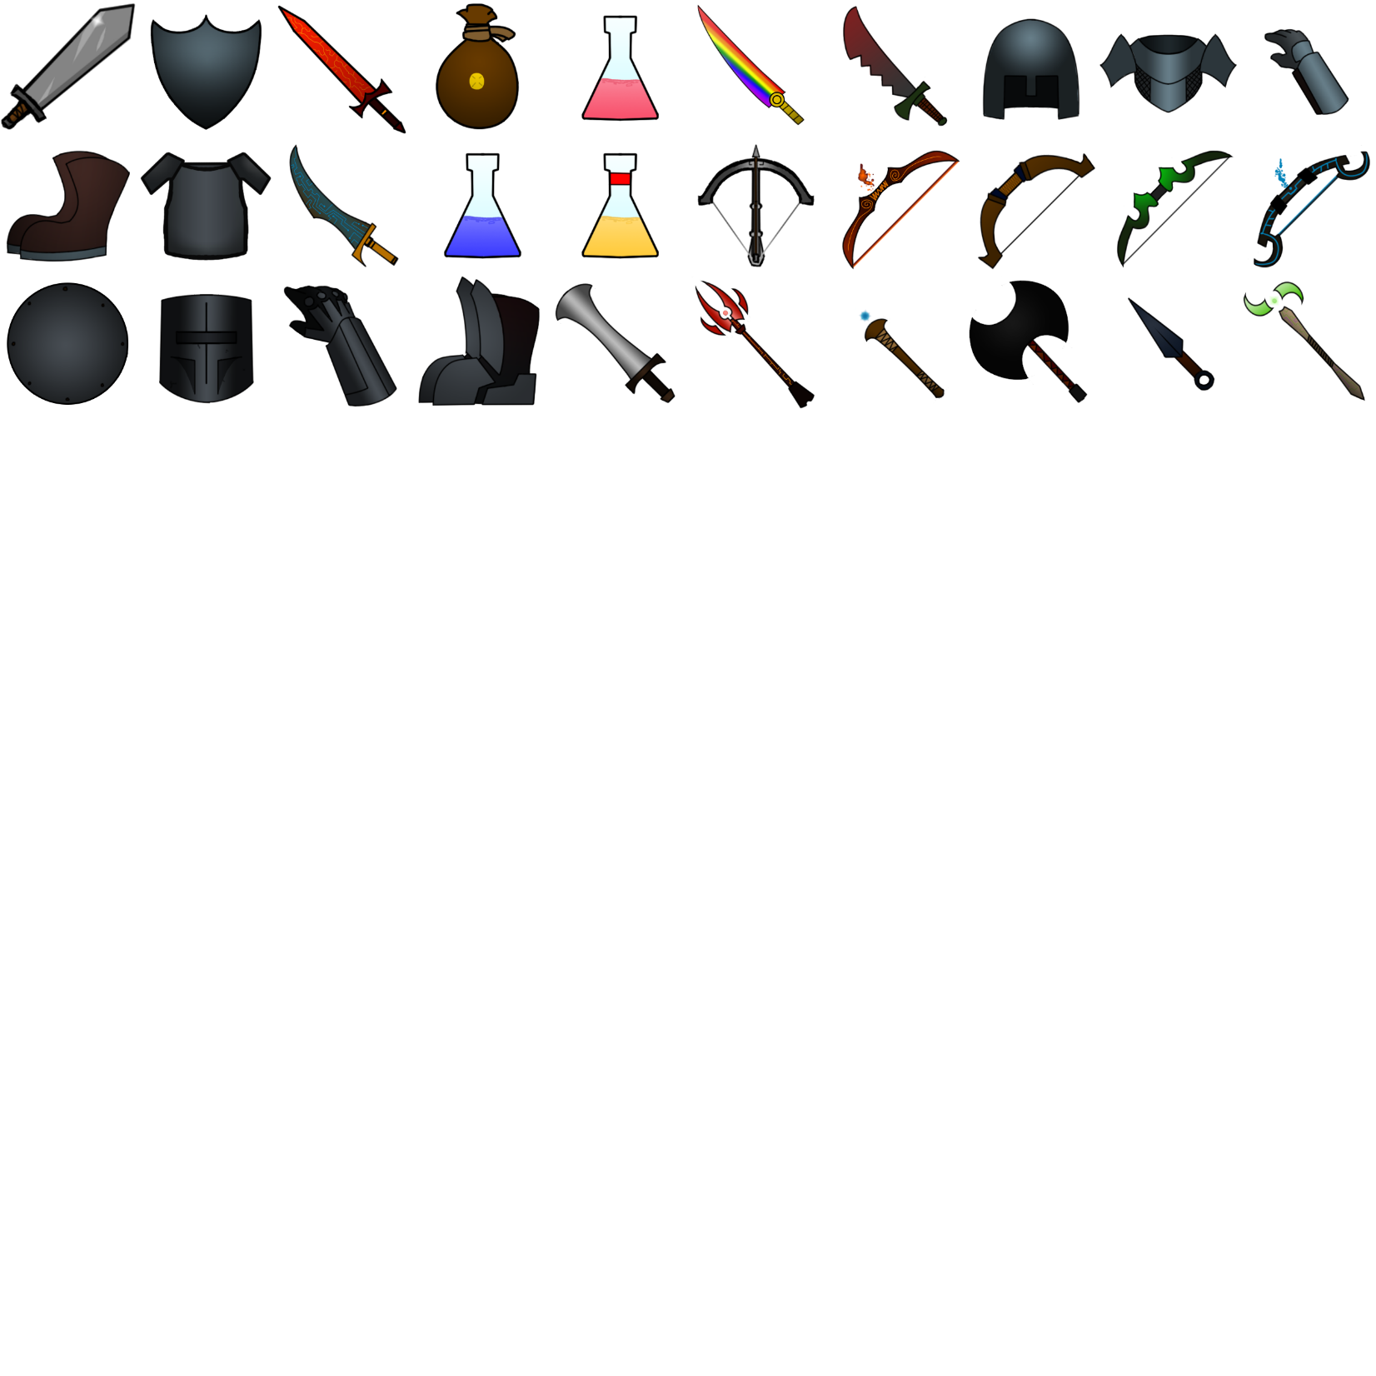
Design Challenges to Overcome
5
Developing for touch screen = limited user input
Balancing items and enemies
Establishing communication, collaboration, and scheduling
Notes:
Kenny

Slide 7
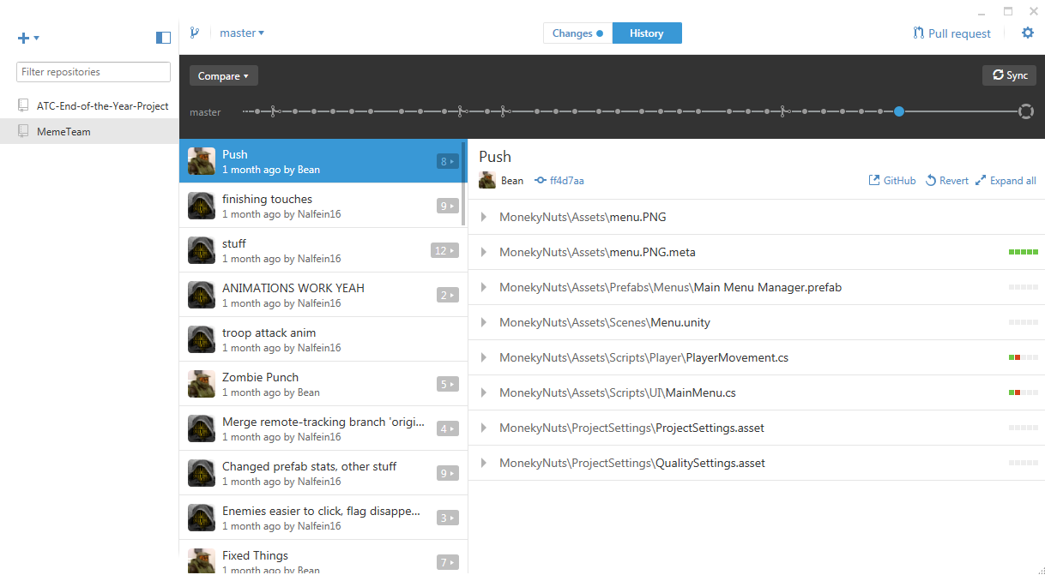
Tools uSed
Notes:
Alex - 23 sec

Slide 8
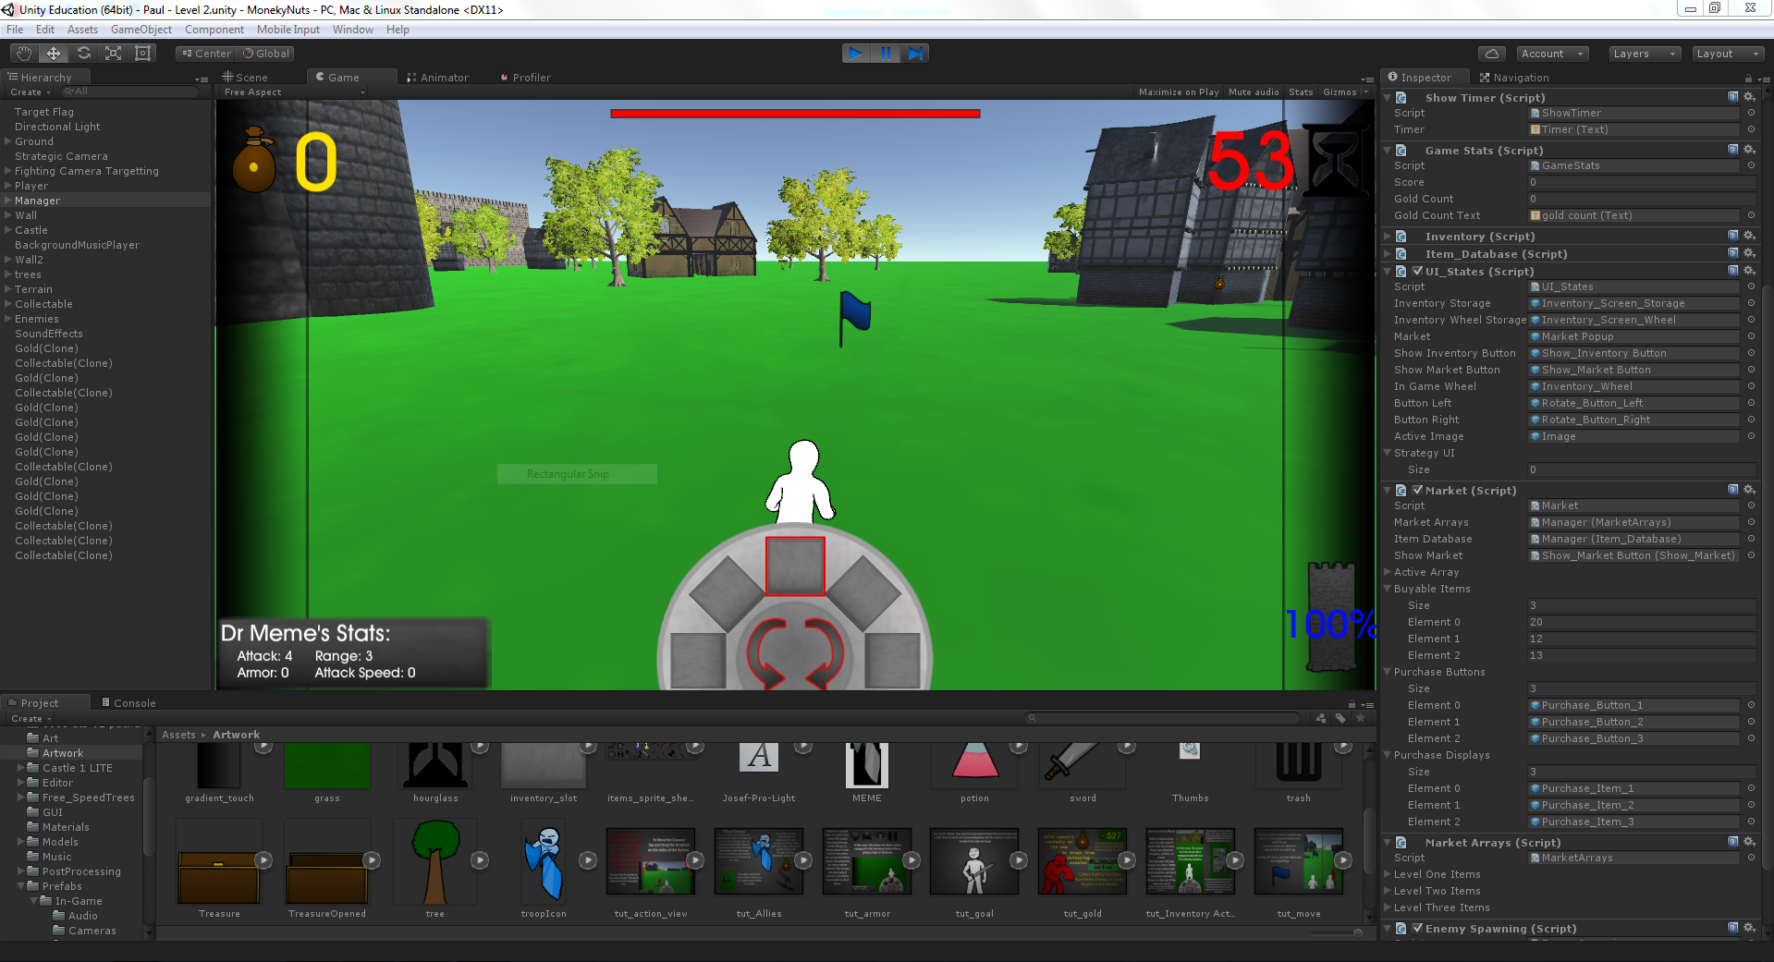
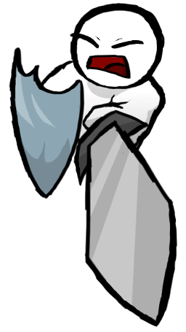
Tools Used
1
GitHub – project sharing
Unity (C#) – programming
Audacity – sound
Mixamo – animations
Soundation – music
Blender – 3D models
Photoshop CC – 2D artwork and sprites

Slide 9
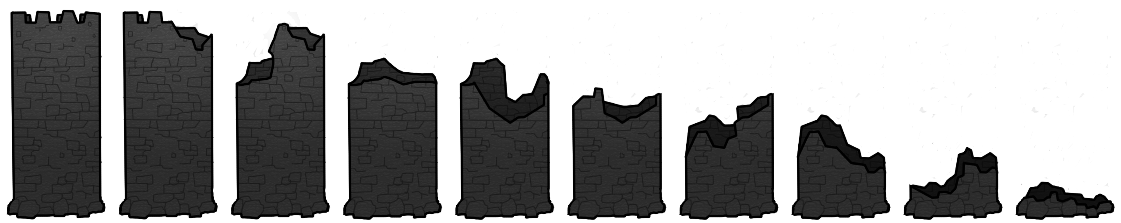
Inner Workings
3
States and timing
Player movement
Inventory and hot bar (active items and armor)
Notes:
Kenny and Paul

Slide 10
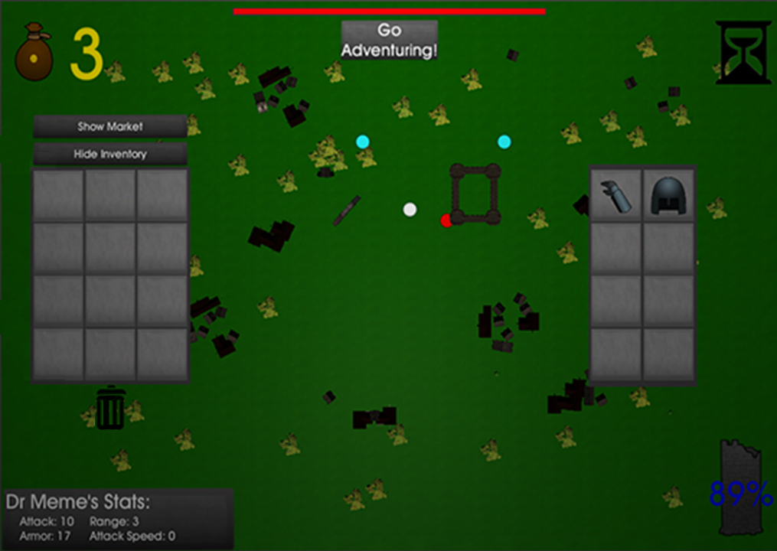
Inner Workings
4
States and timing
Player movement
Inventory and hot bar (active items and armor)
Enemy behavior
Intentions and Actions
Notes:
Kenny

Slide 11
Creation Challenges to Overcome
6
Movement/camera issues
Commits wouldn’t push
Collaborative issues and miscommunication
Notes:
Kenny

